Slide 1
Pennsylvania Economic Index
A review of the economic metrics from the 2010 US Census for each county in Pennsylvania.
Purpose of improving economic distribution across the state.
Kyle Gill

Slide 2
Purpose
Use exploratory data analysis to view economic distribution in PA
Create economic metric to gauge county’s ranking
Utilize local county venue categories to find economic trend
Advise the state or methods for equalizing economic distribution

Slide 3
Data Used
PA Economic data from the 2010 US Census
Breakdown of per capita income, median household income, and median family income by county
PA County latitude and longitude locations
Centroid of the county via .xlsx file from state government
JSON file of county borders from state government
Near-by venues gathered from Foursquare

Slide 4
Economic Data and Economic Index
The three data points for each county are: Per Capita Income, Median Household Income, Median Family Income
Determination of economic rnak was done though Economic Index metric:
Scaled each of the three economic metrics
Took mean of three to determine the index

Slide 5
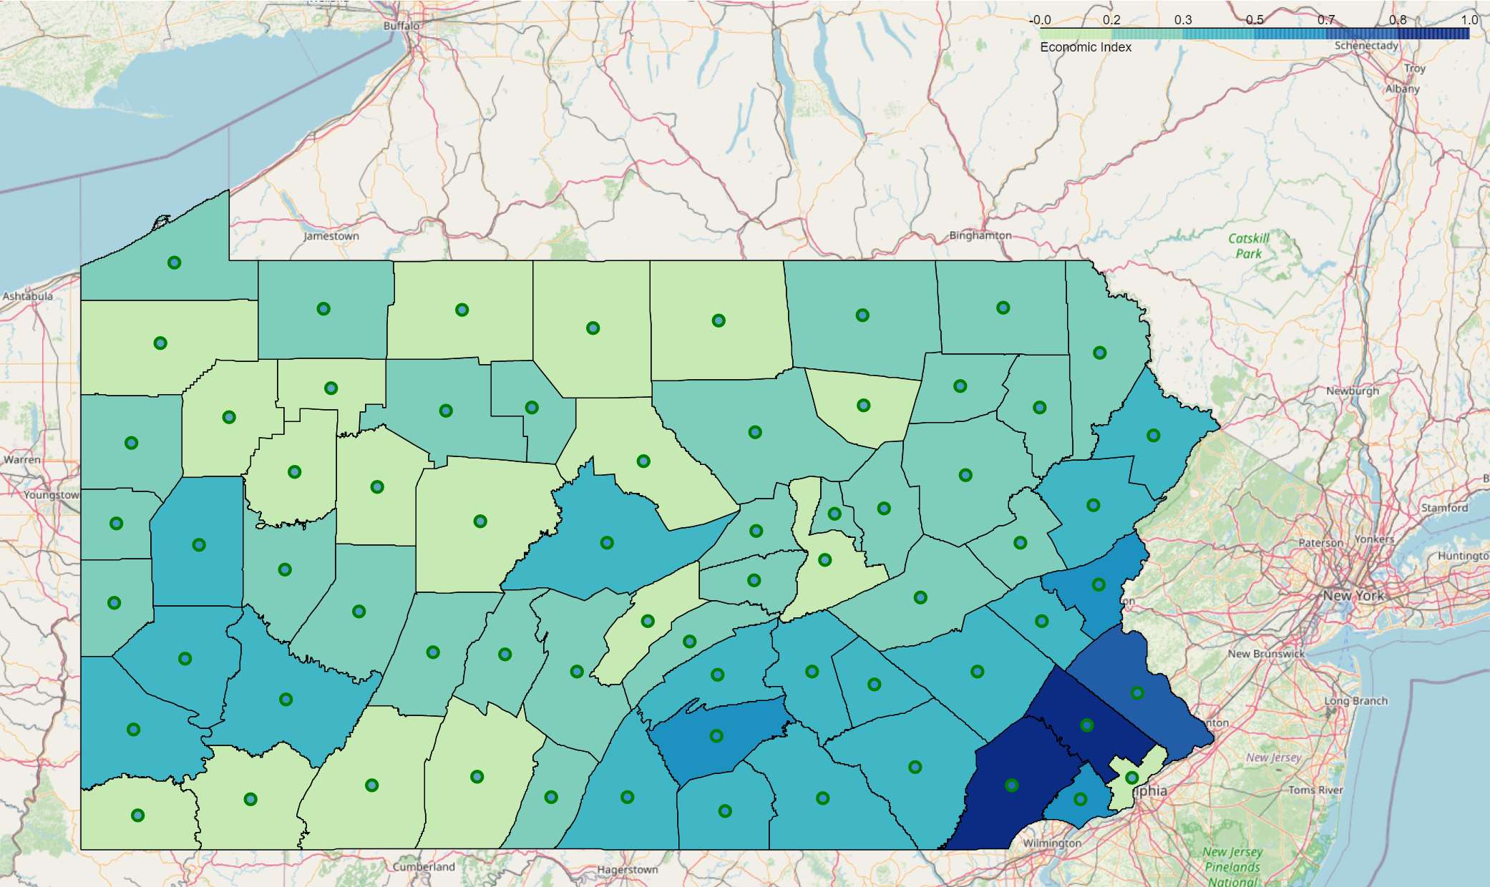
Economic Distribution in PA

Slide 6
Machine Learning Methods
Multiple Linear Regression
Fit number of venues per category in each county against economic index
Venues with larger (+) coefficients tend to improve economic index the most
K-Means Clustering
Segment the venues into three groups:
Increase economic index
Decrease economic index
No affect on economic index

Slide 7
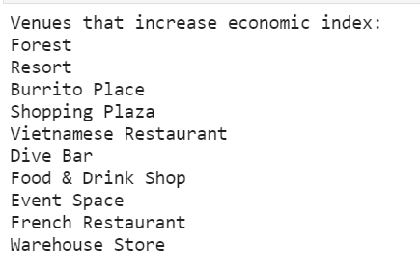
Results – Linear Regression
Multiple Linear Regression yield strong results with R2 near 1.0
Output results indicated international inspired restruants, resorts, and shopping plazas help bring in tourists and high-wage workers to a county

Slide 8
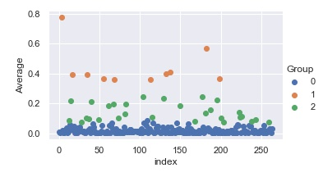
Results - Clustering
Clustering method did not replicate accurate results
Likely due to not filtering out high-frequency venues common to all counties or using reflective economic index factoring metric to place weight on each

Slide 9
Concluding Marks
To increase distribution of economic metrics in PA, the state should focus on increasing the number of resorts, shopping plazas, and international restaurants in low index counties
Improvement of the clustering method would be to:
Filter out high-frequency venues
Modify economic index factor method to scale number of venues per county before multiplying by the economic index
This dataset is not fully encompassing as it relies on the county centroid to obtain venues
A scaled mean of the three economic data points is not sufficient for determining true economic ranking throughout the state
Venues in each county is not only driver of economic prosperity as regional resources, near-by hubs, and corporate offices are larger factors at attracting high-wage residents

